Slide 1
CareerCrafter - Job Portal
A Web-Based Job Portal System

Slide 2
Problem Statement
CareerCrafter is a web-based application that aims to address these challenges by providing a robust platform for employers to post job listings and for job seekers to search, apply, and manage their applications. The application will also include a resume database feature, allowing job seekers to store and share their qualifications seamlessly.

Slide 3
Proposed Solution
CareerCrafter provides a web-based platform for:
Posting and managing job listings
Searching and applying for jobs
Managing resumes and applications

Slide 4
Key Features
- User Registration & Authentication
- Employer Dashboard
- Job Seeker Profile Management
- Resume Database
- Application Tracking

Slide 5
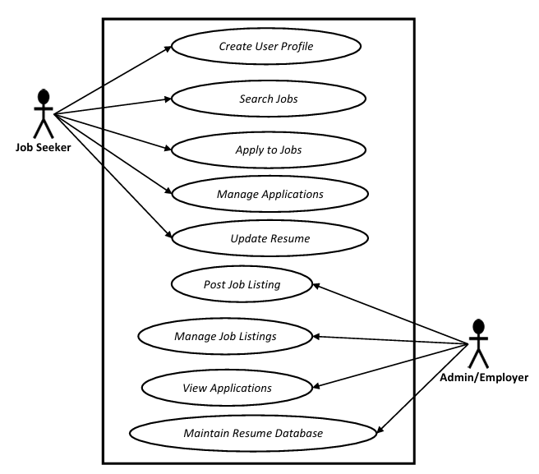
Use Case Diagram

Slide 6
Employer Module
- Post job listings
- Edit and manage job postings
- View candidate applications
- Track applicant profiles

Slide 7
Job Seeker Module
- Create and update profile
- Search jobs using filters
- Apply to jobs
- Track application status

Slide 8
Security - JWT Authentication
- Token generated on login
- Token sent with each request
- Server validates token
- Ensures secure access and authorization

Slide 9
Technologies Used
Frontend: React.js
Backend: Java (Spring Boot)
Database: MySQL
Authentication: JWT
IDE: Spring Tool Suite (STS)

Slide 10
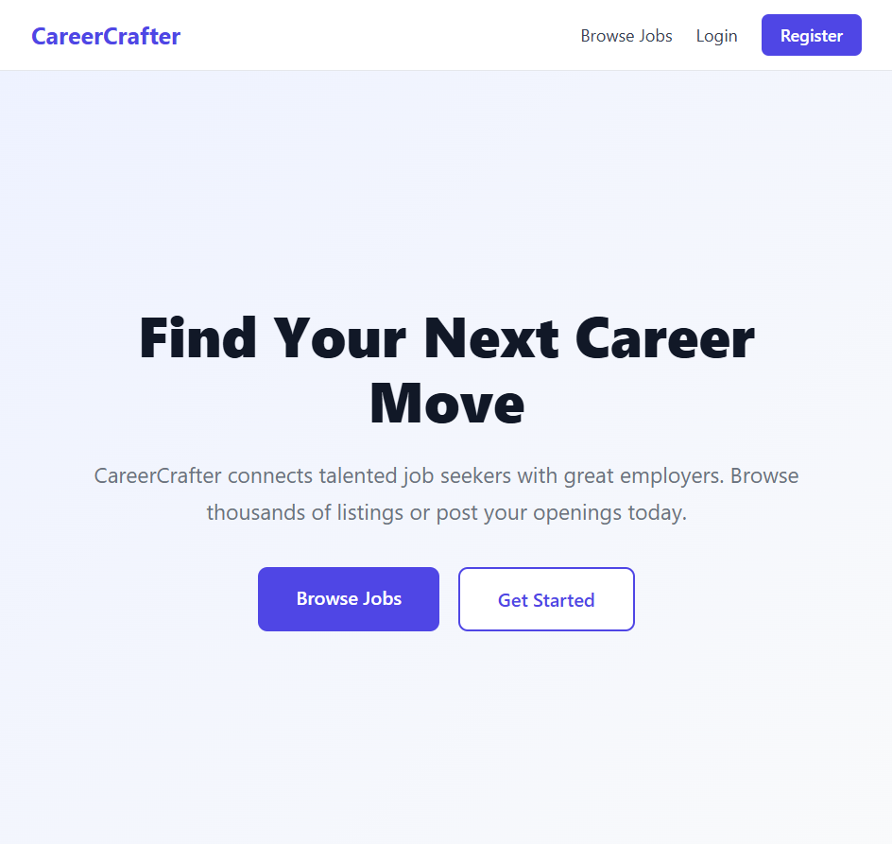
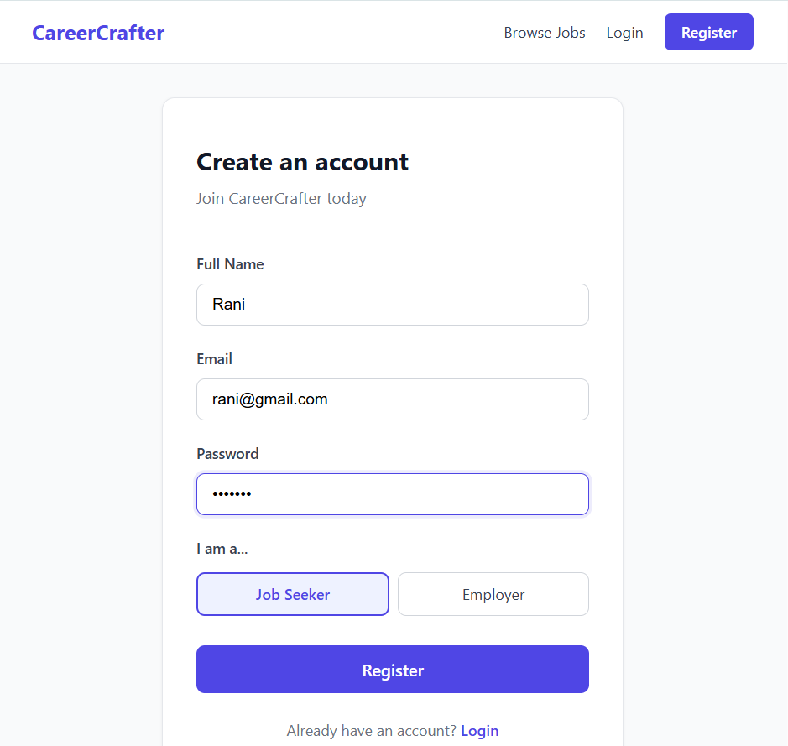
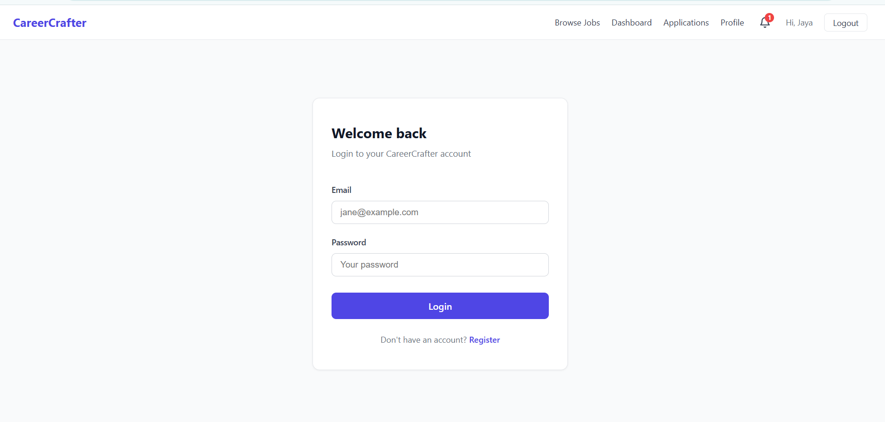
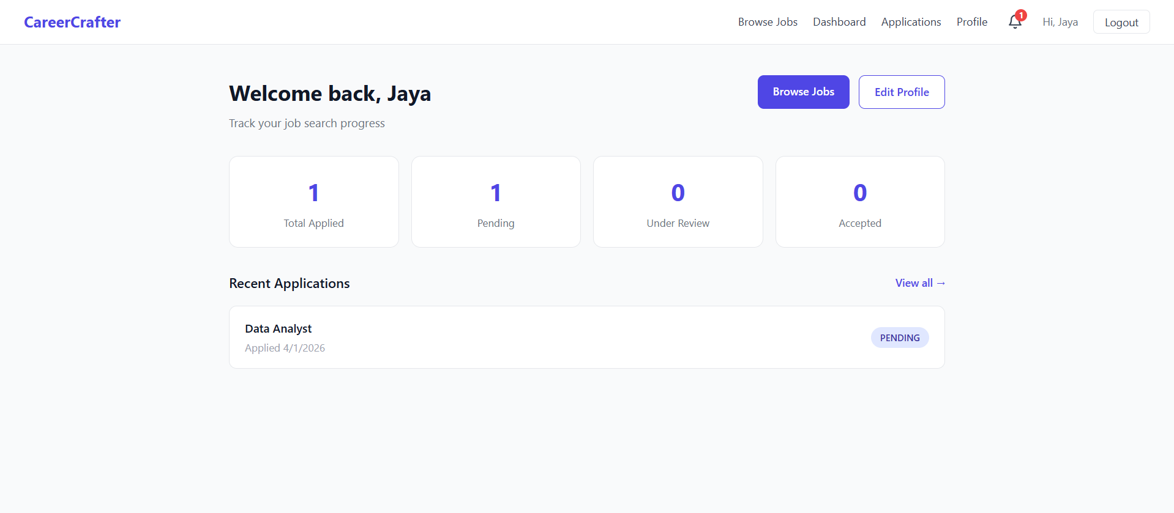

Slide 11
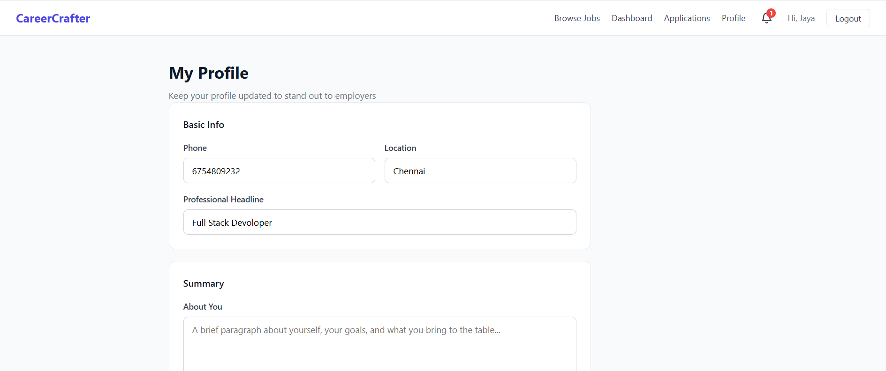
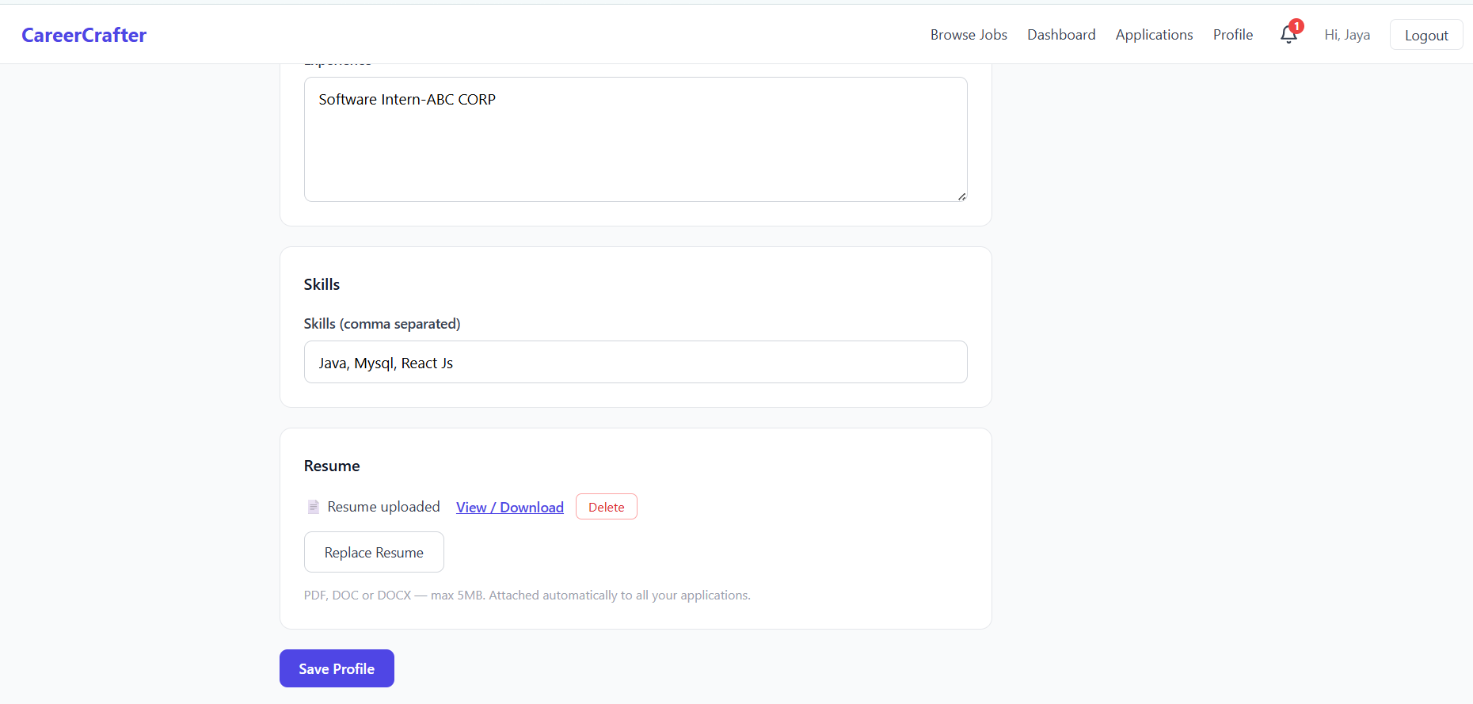
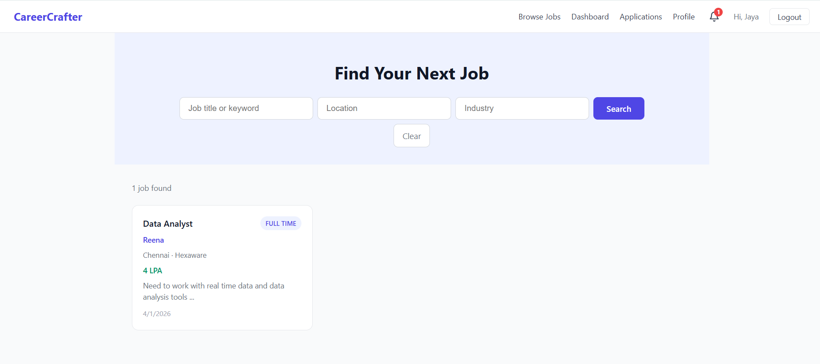
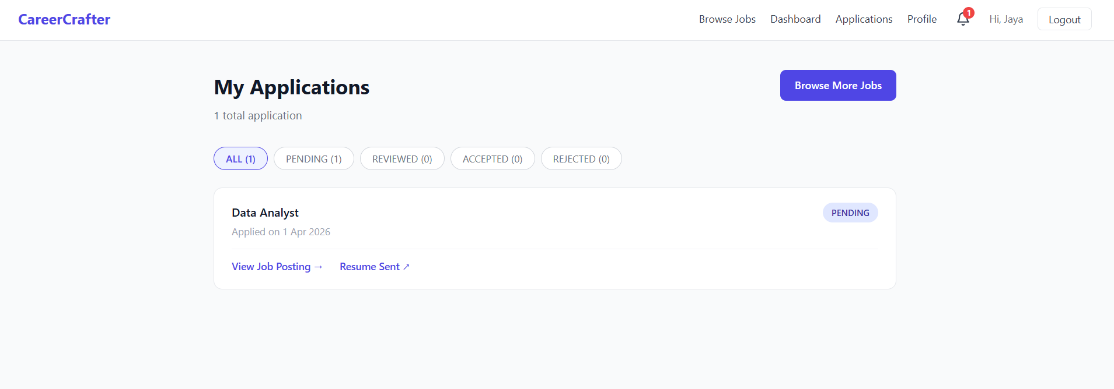

Slide 12
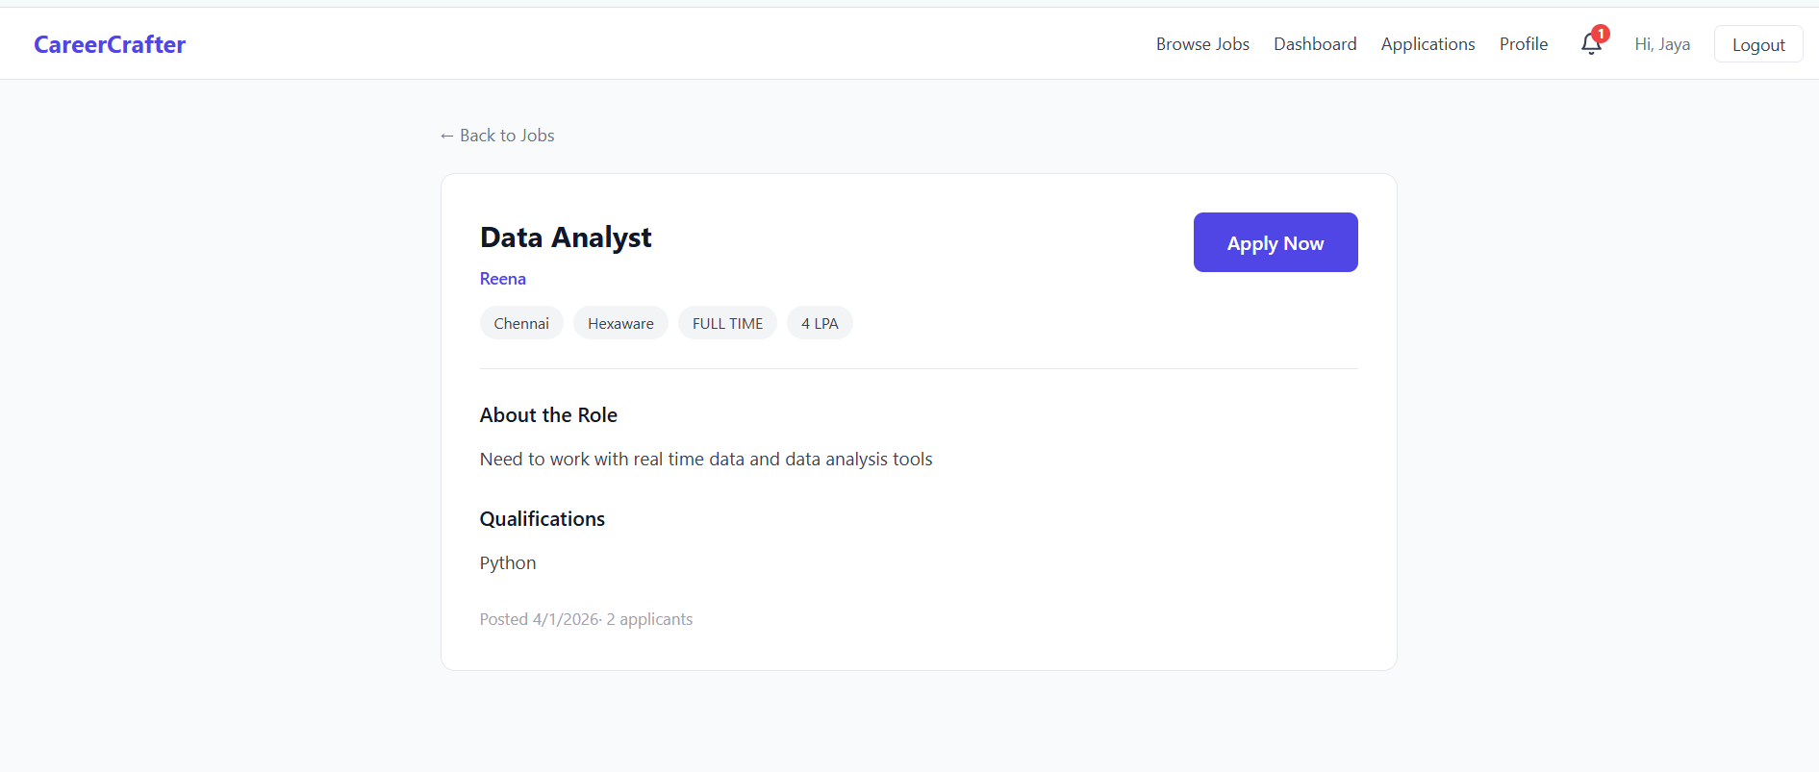


Slide 13
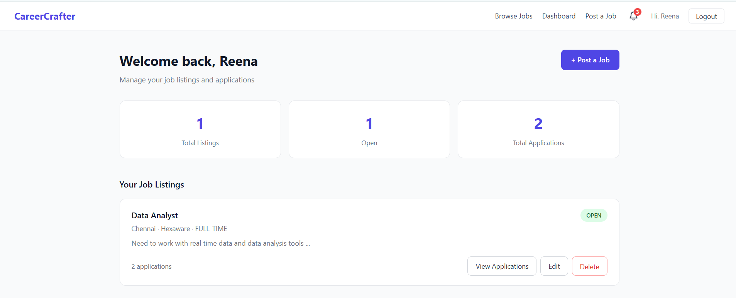
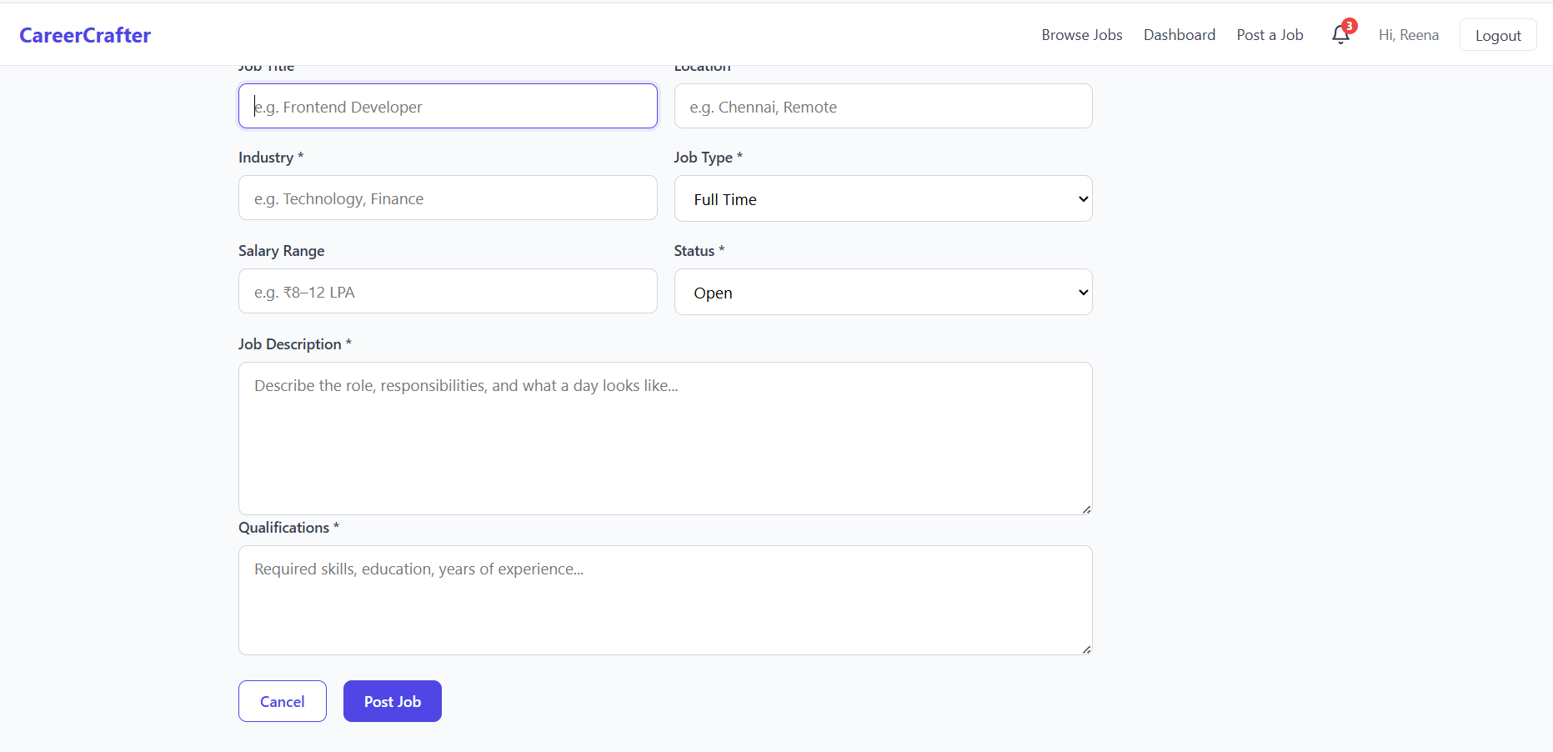

Slide 14
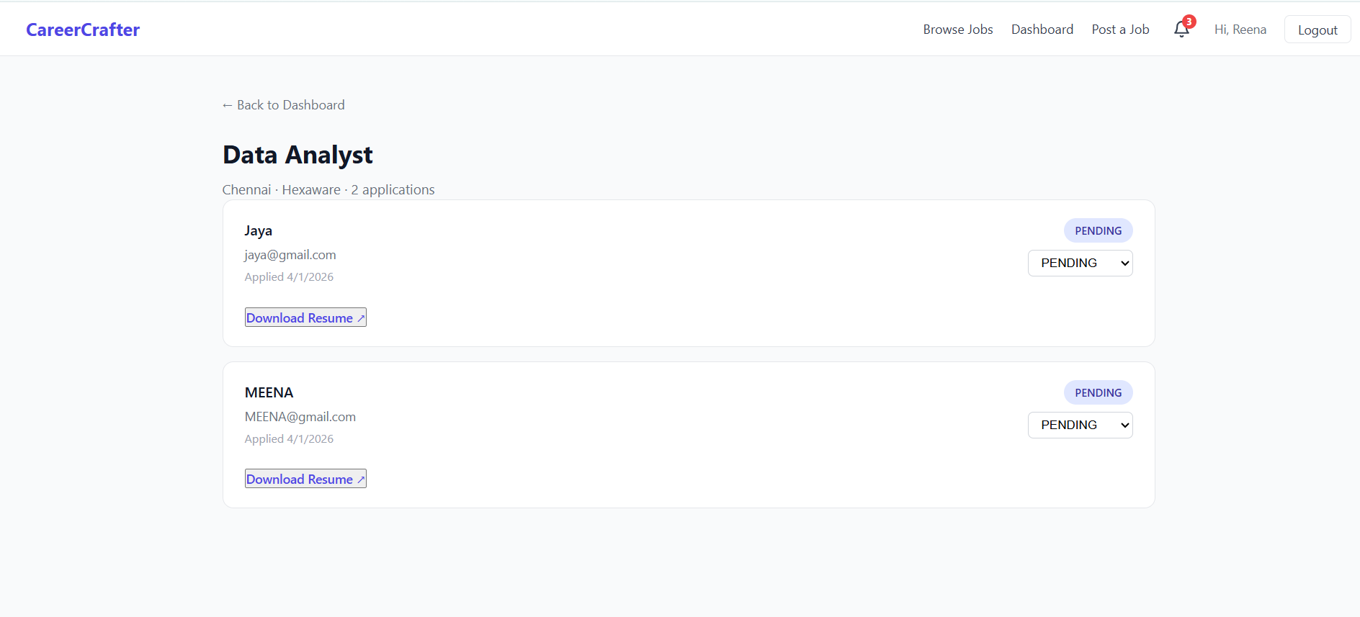
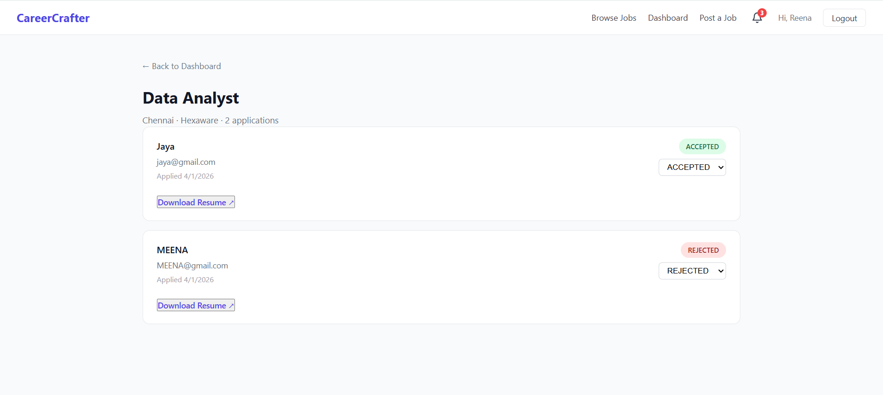
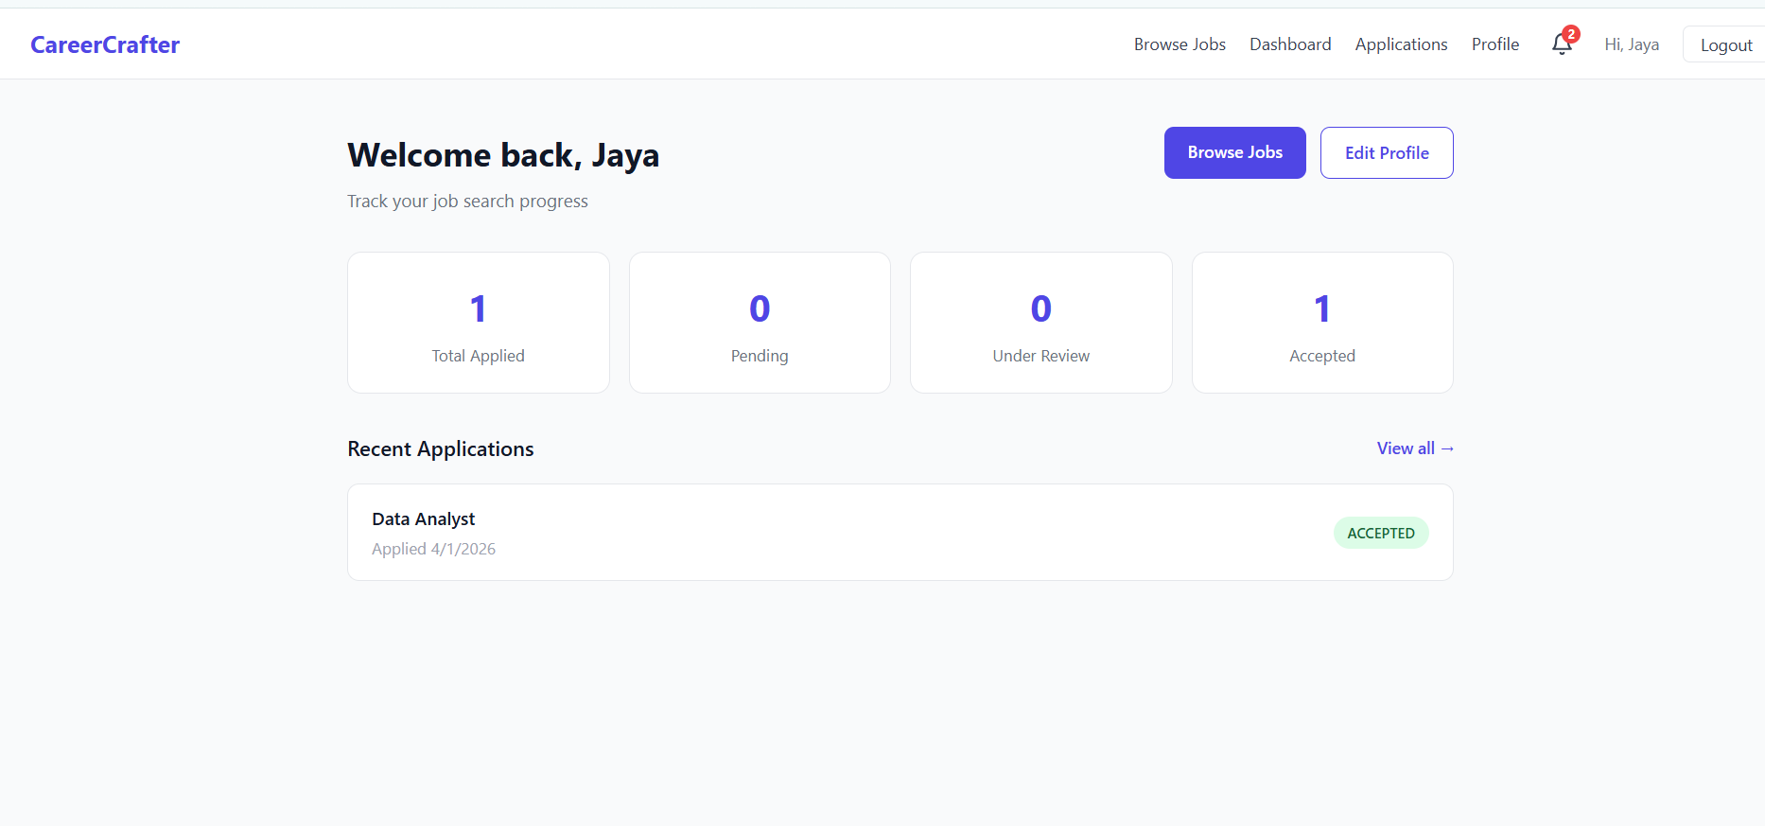
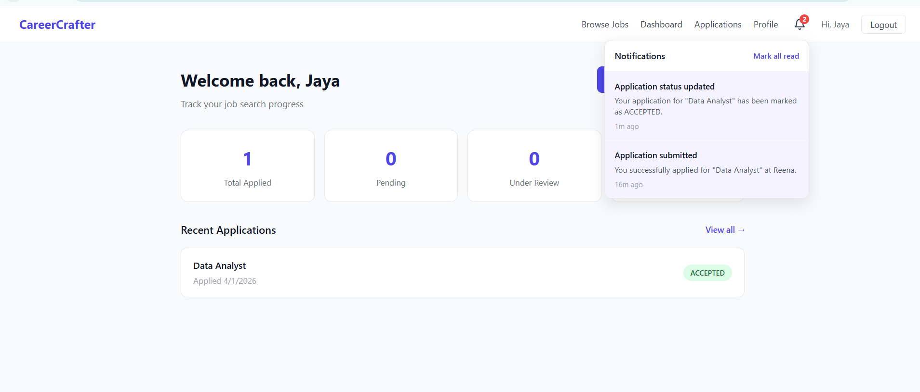

Slide 15
Conclusion
CareerCrafter simplifies recruitment process.
Provides efficient job search and hiring platform.
Scalable and secure using Spring Boot.
Future scope: Add recommendations and enhancements.

